Slide 1
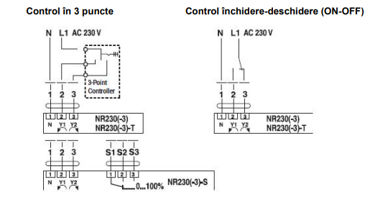
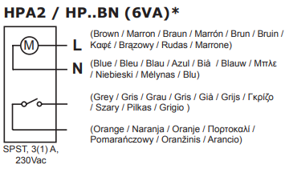
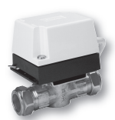
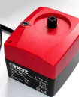
herz nr230-455 1 7712 63

Slide 2
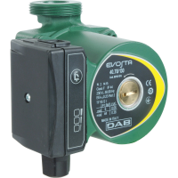
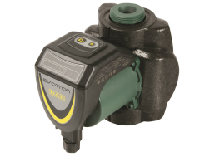
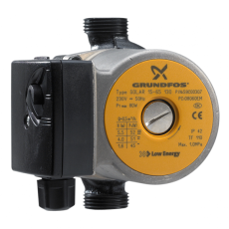

DAB EVOSTA
DAV EVOTRON

Slide 3
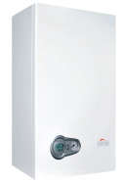





Gaz
boiler
puffer

Slide 4

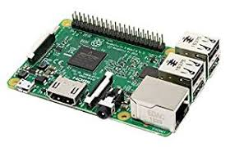
L
+
N
-
L
+
N
-
L
+
N
-
Need
heating?
No
Heat in puffer?
Switch
done?
Yes
1
2
L
+
N
-
3
L
1
2
L
+
N
3
L
-

